Slide 1

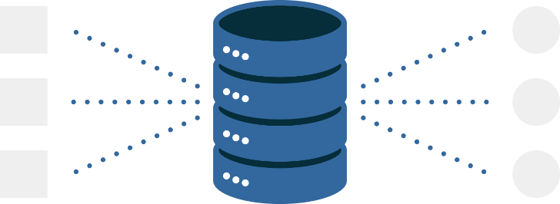
Introduction To Data Warehouse
Lecture 3
Fahad Maqbool
Department of Computer Science

Slide 2
Agenda
What is a Data Warehouse?
Why Data Warehouse?
Speed Up
Scalability

Slide 3
The Need!
“Drowning in data and starving for information”
“Knowledge is Power, Wisdom is Absolute Power”

Slide 4
Historical overview: Crisis of Credibility

What is the financial health
of my company?
??





-10%

+10%


Slide 5
Why Data Warehouse?
Data recording and storage are growing.
History is an excellent predictor of the future.
Gives a total view of the organization.
Intelligent decision support is required for decision-making.

Slide 6
How Much Data is that? *
1 MB | 2²⁰ or 10⁶ bytes | Small novel – 3¹/₂ Disk
1 GB | 2³⁰ or 10⁹ bytes | Paper in the bed of a pickup
1 TB | 2⁴⁰ or 10¹² bytes | 50,000 trees made into paper and printed
2 PB | 1 PB = 2⁵⁰ or 10¹⁵ bytes | All U.S. academic research libraries
5 EB | 1 EB = 2⁶⁰ or 10¹⁸ bytes | All words ever spoken by human beings

Slide 7
Few Examples
Walmart: 24 TB
France Telecom: ~ 100 TB
CERN: Up to 20 PB by 2006
Stanford Linear Accelerator Center (SLAC): 500TB

Slide 8
Note!
A Warehouse of Data
is NOT a
Data Warehouse

Slide 9
Caution!
Data Size
is NOT
Everything

Slide 10
Businesses want much more…
What happened?
Why it happened?
What will happen?
What is happening?
What do you want to happen?

Slide 11
What is Data Warehouse?
The Data Warehouse is an integrated, subject-oriented, time-variant, non-volatile database that provides support for decision-making.
Subject Oriented
Time-Variant
Non-Volatile
Organized along the lines of the subjects of the corporation. Typical subjects are customer, product, vendor and transaction.
Every record in the data warehouse has some form of time variancy attached to it.
Refers to the inability of data to be updated. Every record in the data warehouse is time stamped in one form or another.

Slide 12
What is Data Warehouse?
A complete repository of historical corporate data extracted from transaction systems that is available for ad-hoc access by knowledge workers.

Slide 13
What is a Data Warehouse?
It is a blend of many technologies, the basic concept being:
Take all data from different operational systems.
If necessary, add relevant data from industry.
Transform all data and bring into a uniform format.
Integrate all data as a single entity.

Slide 14
What is a Data Warehouse?
It is a blend of many technologies, the basic concept being:
Store data in a format supporting easy access for decision support.
Create performance enhancing indices.
Implement performance enhancement joins.
Run ad-hoc queries with low selectivity.

Slide 15
How is it Different?
Business user
needs info
Answers result
in more questions
User requests
IT people
?

Business user
may get answers
IT people do
system analysis
and design
IT people
send reports to
business user
IT people
create reports

Slide 16

How is it Different?
100%
0%
Operational
DWH
Bus Service vs Train

Slide 17
Why is this Hard?
There are no stable requirements in a data warehouse environment.
SDLC modeling does not work, as the typical turnaround is in years.
Familiar database techniques break down in DSS at a large scale.
CS people are trained in OLTP techniques, here performance issues are different.
The scale factor in VLDB implementations is difficult to comprehend.
Talking of databases 500GB+ up to 100TB

Slide 18
Why is this hard?
Performance impacts are often non-linear.
For millions of rows, O(n2) really hurts as compared to O(nl g n)
Complex architectures for deployment.
Domain of MPP instead of SMP or PC/RISC
Rapidly changing product characteristics.
And so on...

Slide 19
Reality Check!
Hardware is the easy ware…
…software is the hardware.

Slide 20
Reality Check!
If the software doesn’t scale up, it doesn’t matter how much your hardware can scale up!

Slide 21
Amdahl’s Law
Sequential Execution:
1 2 3 4 5 6 7
Ideal Parallel Execution:
1 2 3 4 5 6 7
Let “s” be the fraction of the program that must be performed sequentially.

Slide 22
Amdahl’s Law
Quantitative representation:
SpeedUp = 1 / ( Percent Sequential + (Percent Parallel / # of Processors) + Overhead)
SpeedUp = 1 / ( 0.1 + (0.9 / 4) + 0 ) = 3.08
The keys to parallel performance:
Amount of parallelism
Overhead management

Slide 23
Amdahl’s Law
100
90
80
70
60
50
40
30
20
10
0
100 Processors
50 Processors
Effective performance
25 Processors
10 Processors
0 2 4 6 8 10 12 14 16 18 20 22 24
% Sequential Execution
At 98% parallelization and 100 processors, with effective performance of 60 Processors, what are the 40 processors doing?

Slide 24
Scalability – It’s Not Just About Volume
Amount of Detailed Data
Concurrent Users
Complexity of Data Model
Query Complexity
Simple Direct at the start
Moderate Multi-table Join
Regression analysis
Query tool support

